Slide 1
Acme Retail Sales
Presented by:
Cameron Cromer

Slide 2
What is the problem?
http://cep.org/wp-content/uploads/2015/10/confronting-overwork-1.jpg

Slide 3
Why is the problem is important
https://marketingland.com/wp-content/ml-loads/2016/02/efficiency-ss-1920.png

Slide 4
Proposed solution
http://www.bmc.com/blogs/saas-help-desk-software-comparison-features-look/

Slide 5
How it will help
https://mva.microsoft.com/en-us/training-courses/sql-database-fundamentals-16944?l=w7qq6nAID_6805121157

Slide 6
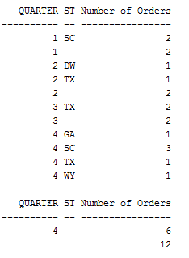
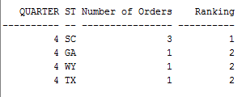
Reports
Fig. 2. Rollup Report
Fig. 1. Dense Rank Report Quarter 4

Slide 7
Conclusion
https://logicalread.com/wp-content/uploads/2017/07/Eye-Opening-Discoveries-About-Help-Desk-Security-and-What-to-Do.png

